Slide 1
Roles
File Reader:Péjó Kristóf
Number plate Reader Molnár Márk Krisztián
Colordetection: Gróf Richárd László

Slide 2

Project Manager tools
What we used for the group project was:
Trello
Github

Slide 3

The Program that we used for the Project
We used Pycharm for the project

Slide 4
Number Plate Reader
Made by Molnár Márk Krisztián

Slide 5
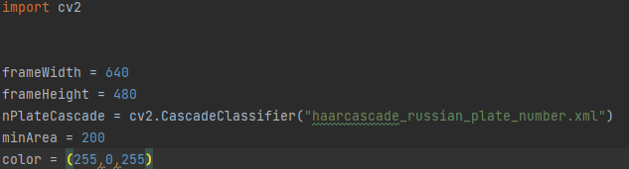
The Code’s structure
Import Libraries
Set the screensize
Load in the file
Set the detection area
And set the detection indicator color

Slide 6
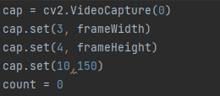
We set the programme to search number plates base on the camera’s picture
Setting the recording’s size.

Slide 7
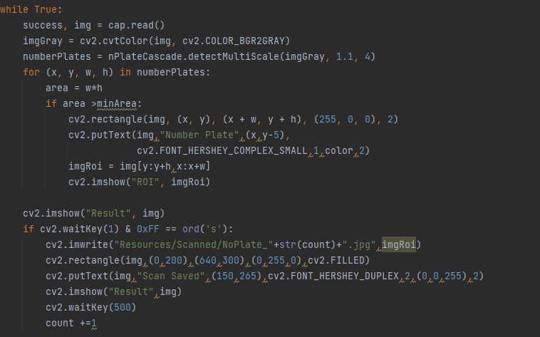
Reading the picture
Making a gray picture for the better detectability
Detecting number plate
Drawing a square around the number plate
Showing the numberplate in a different window

Slide 8
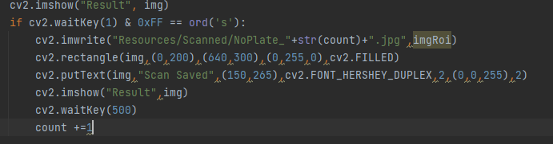
Showing the picture
Marks the number plate it’s detecting.
The square’s datas
It says that it could save the resault.
Shows the detected picture.

Slide 9
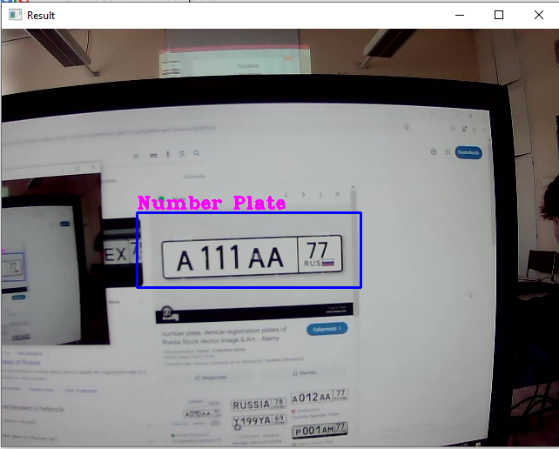
Testing the code
I tested the code by searching up some russian number plates and showed it to the camera.

Slide 10
Describeing the program
When we start the program a window pops up and it starts to search for a russian number plate.
When the camera detects a russian number plate it show you in a different window wich one did it find and saves it.
Fin.

Slide 11
File Reader
Made by: Péjó Kristóf

Slide 12
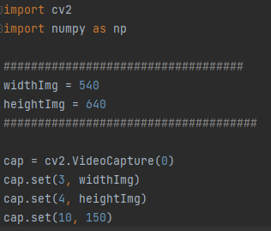
The Code’s structure
Import the cv2 and numpy directory
Save the width to variable (540) and height (640).
Opens the default camera.
Set the camera’s width and height
Set the Brightness of the camera(150).

Slide 13
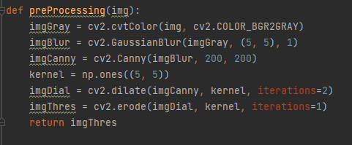
Convert the picture to gray
Use blur on the picture
Use Canny Edge filtering
Extend the edges
Use Erotion on the edges
Return the original picture

Slide 14
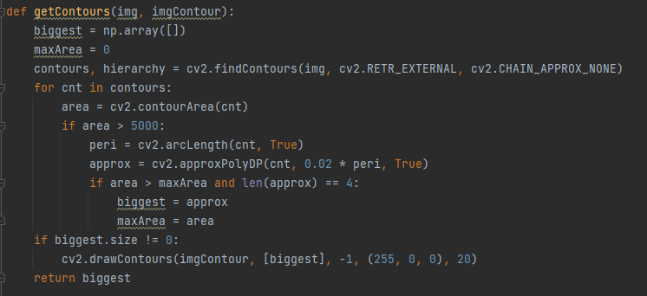
It calculates the contours. It checks the area of the contours. If the area is greater than 5000, it calculates the perimeter. If the contour consists of four sides and has the largest area, it stores it. If it finds the largest contour, it draws it. It returns the largest contour.

Slide 15
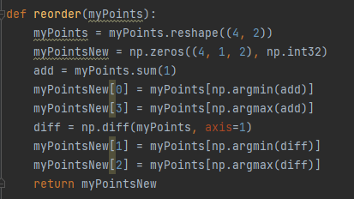
It converts the points into a 4x2 format.
It calculates the sum of the points and sorts them .
It determines the top-left and bottom-right points.
It calculates the difference between the points and sorts them.
It determines the top-right and bottom-left points.
It returns the newly sorted points.

Slide 16
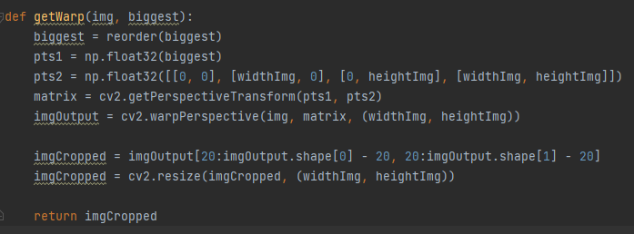
It sorts the contour points
It defines the source points (pts1) and the destination points (pts2).
It calculates the perspective transformation matrix.
It applies the transformation to the image.
It crops and resizes the image.
It returns the transformed and cropped image.

Slide 17
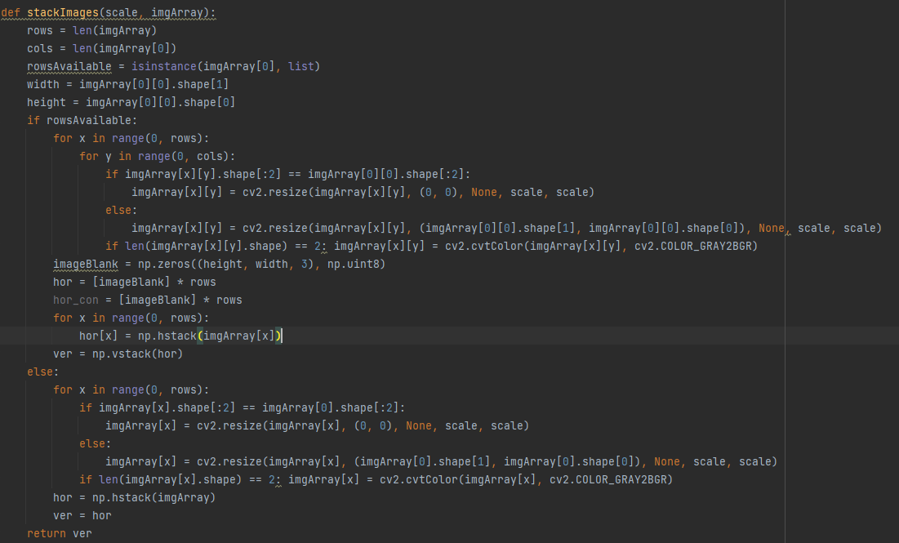
The function is capable of merging multiple images, resizing them, and stitching them together into one large image, taking into account their sizes and color channels.

Slide 18
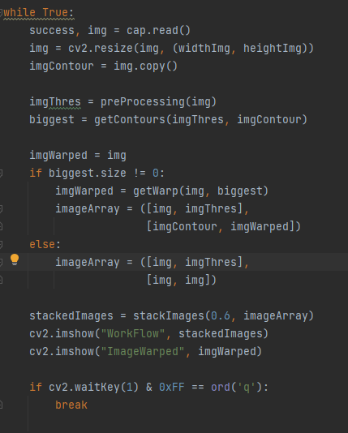
Reading a frame from the camera.
It resizes the image.
Performs preprocessing (preProcessing).
Calculates the contours (getContours).
If there is a valid contour, it performs the perspective transformation (getWarp).
Assembling and displaying the images.
The program stops when the 'q' key is pressed.

Slide 19
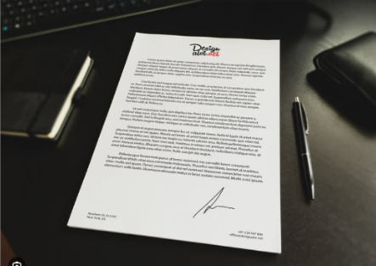
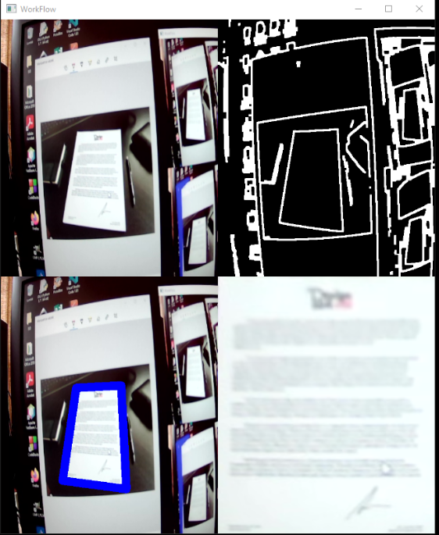
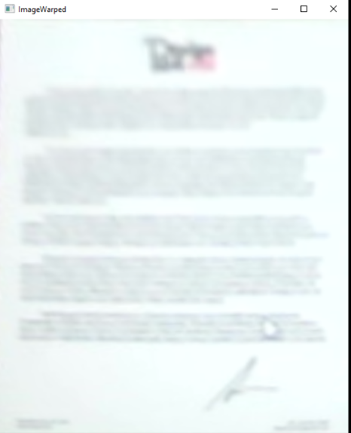
Testing and demonstrating the code

Slide 20
Display drawing, color detection
Made by :Gróf Richárd

Slide 21
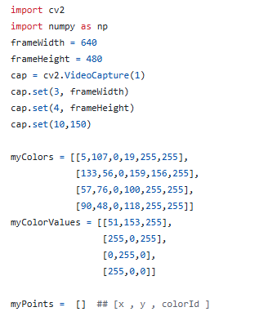
The Code’s structure
You can see all the imported directorys and variables

Slide 22
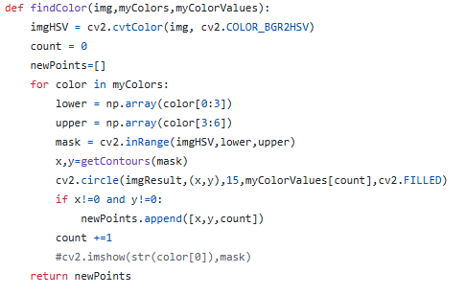
Kód felépítése
Itt a színfelismerő függvényt láthatjuk.

Slide 23
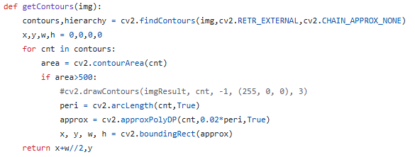
Kód felépítése
Itt a kontúrok meghatározását láthatjuk.

Slide 24
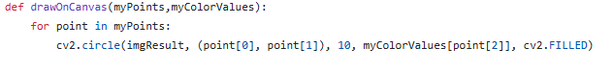
Kód felépítése
Itt a képernyőre való rajzolást láthatjuk.

Slide 25
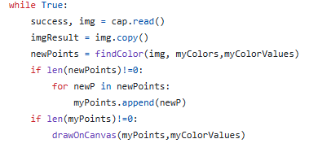
Kód felépítése
Végül, de nem utolsó sorban a rajzolást mutatja be.

Slide 26
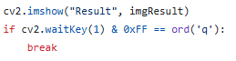
Kód felépítése
Aztán megjelenítjük az egészet.

Slide 27
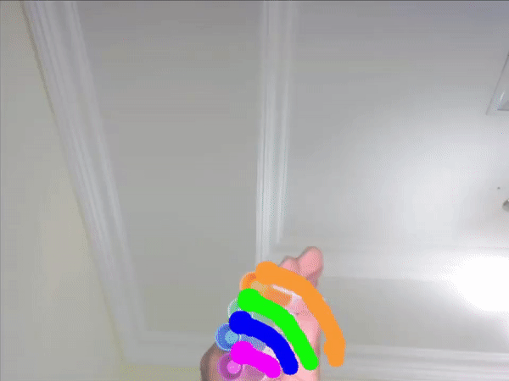
kód tesztelése
Teszteltük, egy bizonyos színű tárgyat odarakva rajzol a képernyőre, ez az állítás.

Slide 28
A program bemutatása
A programot elindítva a kamera megjelenik, ha egy bizonyos színű tárgyat odatartunk akkor tudunk vele az azonos színnel rajzolni..

Slide 29
Vége
Köszönjük a figyelmet! Készítette: Molnár Márk, Péjó Kristóf, Gróf Richárd

